Slide 1
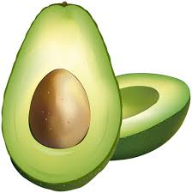
“In the News”
Devin P. Ramnarain
NTR 355-A-24644-24645

Slide 2
Article Basics:
Title: “The Ketogenic Diet: A Detailed Beginner’s Guide to Keto”¹
Rudy Mawer, MSc, CISSN
July 30, 2018
Healthline.com¹
URL: https://www.healthline.com/nutrition/ketogenic-diet-101

Slide 3
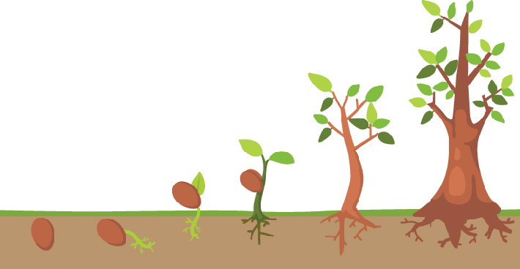
Life Cycle Stage
Primarily, those in the adult stages are encouraged to try the Standard Keto diet (or SKD) (Early, Mid, and Senior Adult), but children in preschool to grade school are targeted for specified treatment (especially epilepsy and cancer).
This diet would be most interesting to those in their teens to elderly years, particularly those wanting to lose significant body weight. This meal plan may interest individuals who have been diagnosed with/show risk factors for the ailments Keto is thought to treat.

Slide 4
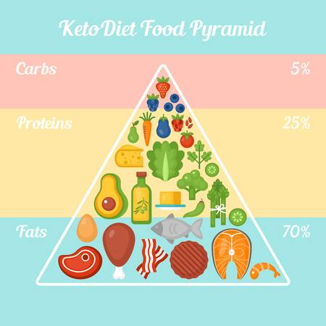
Author’s Point of View/Approach
Rudy Mawer, MSc, CISSN is confident in the health and weight loss benefits of the SKD.
He believes that many Nutritionists fall behind the times in their hesitance to accept the Keto diet as a standard weight loss plan.¹
Mawer describes the health benefits of the SKD with the disclaimer that many of the claims made about treatment are “far from conclusive”¹
He uses a persuasive tone with mild-to-moderate bias in his delivery of information

Slide 5
Others In The Field:
https://www.plantbasednews.org/post/no-one-should-be-doing-keto-diet-leading-cardiologist
I used a Google search and clicked on the third article I saw, from PlantBasedNews.com³⁷
Dr. Kim Williams, an established Cardiologist and former President American College of Cardiology, is strongly against Keto. He states that the science behind the diet’s efficacy is “wrong”³⁷
Dr. Williams calls it a fad diet with low likelihood for long-term results and high risk for negative side effects.³⁷

Slide 6
Key Features: Background
The Ketogenic diet (or Keto diet, SKD) focuses on an increase in fat and a major decrease in carbohydrate intakes.
This SKD suggests fat intakes of 75% fat, 20% protein and 5% carbohydrates to meet daily calories¹.
The of 20% are considered to be high, but the standard person eats between 10% and 30% of their calories in protein.² The main problem is the requirement for ANIMAL protein and dairy, which are high in excess salt and saturated fat. The fat intake suggestion is exorbitant.
The Keto diet contains potential health benefits for SOME of the ailments described, of which we will explore.

Slide 7
Key Features: Author Beliefs
- Weight loss¹
Metabolism efficiency¹
Filling without Calorie Counting¹
Heart disease¹
Cancer¹
Epilepsy¹
Parkinson’s Disease/Alzheimer’s¹
Polycystic Ovary Syndrome¹
Acne¹
Diabetes¹

Slide 8
Key Features: Conclusion
The article ends with a comprehensive-yet-simple diet plan as well as a list of foods to avoid/to focus meals around.
There are many miniature conclusions at the end of each paragraph that summarize the topic, such as describing the potential health benefits and which foods should be eaten.
Most of the science cited in the article has been noted to require further review, and some of the scholarly journals themselves returned inefficient/inconclusive, unrelated, or even negative data.

Slide 9
Key Features: Reasoning and Evidentiary Support
Mr. Mawer gives very comprehensive meal plan advice but somewhat vague scientific information with regard to specific health benefits
Some of the scientific evidence is well cited, but some claims are cited with inconclusive or misleading sources.
Mr. Mawer is honest regarding need for more clinical information about the Keto diet and its specific benefits for ailments, but strongly believes in its efficacy
The article overall is fairly open to each person’s interpretation (as to whether they would benefit from SKD or not), but there appears to be a bias toward the meal plan. This is enhanced by observing Mr. Mawer’s personal benefit (potential commission from Healthline and interest in selling his own Keto diet plans).

Slide 10
Author Evidence and Reasoning
Weight Loss:
Claim: “A Ketogenic diet is an effective way to lose weight and lower risk factors for disease”¹
Article 1: The first article cited states further information is needed.⁴
Article 2: The second article suggests that SKD may be helpful but may cause metabolic imbalances by activating the body’s PPAR (Peroxisome proliferator-activated receptor) system.⁵
Article 3 is speaking about a high carbohydrate and low fat diet eaten specifically by patients with Syndrome X (a metabolic syndrome) and so does not apply to the general public as a whole.⁶
Article 4 specifically states Acyl CoA moiety as potentially harmful in EXCESS with regard to stimulation from excess insulin, but regulation via a low carb (vs carb-free) diet would likely produce more balanced long-term effects.⁷

Slide 11
Author Evidence and Reasoning
Weight Loss (Continued):
Claim: “A Ketogenic diet is an effective way to lose weight and lower risk factors for disease”¹
Article 5: Muscle reduction; This article suggests that the liver produces ketone bodies that it cannot use and so sends them to the brain and muscle for energy use in the stead of glucose.⁸ However, the brain is said to only function at 2/3 capacity this way and ketones are not recommended as brain food long-term.⁹ Also, this study was only conducted for 10 days, not sufficient for evaluation of starvation metabolism.⁹
Article 6: This is actually an article I also found (separately); it states that patients who tried SKD for 3 10-day periods lost, on average, lost twice as much weight than with a standard reduced calorie diet maintaining the standard % of fat/carbs/protein recommended by the FDA. HOWEVER, the extra weight lost on the SKD was 100% water. This may explain why so many Keto users “plateau” and end up giving it up. Ketosis requires slight dehydration to maintain itself. I’m not sure why the author would include this article to convince others toward Keto.¹⁰

Slide 12
Author Evidence and Reasoning
Metabolism Efficiency:
Claim: “eduction in carbs puts your body into a metabolic state called ketosis.
When this happens, your body becomes incredibly efficient at burning fat for energy. It also turns fat into ketones in the liver, which can supply energy for the brain”¹
Article 1: This article suggests favorable changes in HDL cholesterol levels and triglycerides, but other studies have shown an increase in HDL as well as LDL and VLDL cholesterol on the Keto diet.³ This can cause irreparable liver damage.¹¹
Article 2: This study states that endurance cyclists who began a 4-week SKD (following an initial 4-week diet consisting of 2/3 carbohydrates and 1/3 fat) did not lose muscle mass from the SKD. However, 4 weeks is not long enough to evaluate starvation metabolism.⁽⁹⁾⁽³²⁾ Also, the respiratory quotient of these subjects was already dropping some after this short time.¹²
Filling Without Counting Calories:
Claim: “What's more, the diet is so filling that you can lose weight without counting calories or tracking your food intake”¹
Article is agreeable due to the suggested fruits and vegetables in a SKD contain a large amount of fiber. However, eating a moderate amount of high-fiber carbs would also enhance the patient’s satiety without need to count calories (if they still ate this many vegetables).¹³

Slide 13
Author Evidence and Reasoning
Heart Disease:
Claim: “The Ketogenic diet can improve risk factors like body fat, HDL cholesterol levels, blood pressure and blood sugar”¹
Article 1: The weight loss shown after 6 months of the low-carb high-protein diet was greater than the low calorie-low fat (LCLF) diet, but the weights taken at 12 months were pretty homogenous. This suggests that the patients on the Keto diet regained some of the weight lost. The study also showed increased cholesterol (both LDL and HDL) in the Keto patients and not in the low kcal-low fat patients. This article is worded with tricky phrasing, too, so that it appears to be showing positive information about Keto. The article brags about Keto more effective than LCLF at 6 months and as effective if not more so after 12 months, but one must take cholesterol into effect as a long-term potential issue.¹⁴
Article 2: This article states that HDL rose and LDL did not change significantly, but LDL also rose (even with a pretty decent amount of weight lost). Keto seems good for heart disease due to weight loss factors¹⁵, but cholesterol and liver damage⁽¹¹⁾ are of concern.

Slide 14
Author Evidence and Reasoning
Cancer:
Claim: “ The diet is currently being used to treat several types of cancer and slow tumor growth”¹
Article 1: This article does state that brain carcinogenic cells rely heavily on glucose for survival, whereas normal brain tissue can function on ketones as well as glucose. While brain function may not be optimal using ketones, it is a good idea to “starve out” the hungry brain tumor cells this way to optimize other forms of cancer treatment used concomitantly. The study concluded that the tumor cells were smaller in the calorie restricted version of the SKD than in ad libitum, but both versions produced a decrease in carcinogenic activity. This suggests that cancer cells have a harder time metabolizing ketones than glucose, so it seems that the Keto diet may be a good option for fighting cancer.¹⁶
Article 2: This study notes that glucogenic processing via the TCA cycle is manipulated by cancer cells, and that forcing the body into starvation metabolism by utilizing a patient’s adipal intakes may help promote effectiveness of antitumor treatments such as chemotherapy.¹⁷

Slide 15
Author Evidence and Reasoning:
Cancer (Continued):
Claim: “ The diet is currently being used to treat several types of cancer and slow tumor growth”¹
Article 3: Article 3 and Article 1 are the exact same piece of scholarly research, although they are quoted as two separate ones.¹⁶
Article 4: This writer was talking about an SKD in the stead of intermittent fasting as treatment for cancer, but there was no study conducted at this time. However, further research pursuant to Ketotic cancer treatment seems promising.¹⁸
Blocking nutrients from glycogen-hungry tumors makes perfect sense, but close patient interaction advised with the SKD – as cancer patients often lose weight too quickly. They also might not enjoy the diet and may thusly eat too little.

Slide 16
Author Evidence and Reasoning:
Epilepsy:
Claim: “Research has shown that the Ketogenic diet can cause massive reductions in seizures in epileptic children”¹
Article 1: This study had very favorable results. Many of the children who utilized the SKD as treatment were either largely seizure free or free of medications. This study was conducted over a long period of time as well (3 to 6 years), which appears ample time to study nutritive effects. The Keto diet seems to be effective in battling the neurotransmission errors that epilepsy stems from and has been used for treatment of such for over a century.¹⁹
It is established that epilepsy is treated well by the SKD and it is very understandable why clinicians would be eager to see what other neurological illnesses they could block off by restricting glucose to the brain.³³ On a personal side note, I am curious as to its effectiveness in treating diseases like fibromyalgia.

Slide 17
Author Beliefs and Reasoning:
Alzheimer’s Disease:
Claim: “The Keto diet may reduce symptoms of Alzheimer's disease and slow its progression”¹
Article 1: This author is in the hypothetical phase of research regarding the topic. He seems more interested in beta-hydroxybutyrate than in the SKD, calling the high-fat diet “unpalatable and unhealthy”.²⁰ It is well known by nutrition/healthcare researchers that b-hydroxybutyrate activity is stimulated by ketosis. However, it may not be safe to put an elderly patient into long periods of starvation metabolism to accomplish increased activity of these protein substrates – and b-hydroxybutyrate is available intravenously. More research is needed here.⁽²⁰⁾⁽³⁶⁾
Article 2: This is another article hypothesizing the potential neuroprotective qualities of the SKD. It is actually a piece primarily on epilepsy, and no study appeared to be conducted for Alzheimer’s/Parkinson’s here either.²¹

Slide 18
Author Beliefs and Reasoning:
Alzheimer’s Disease (Continued):
Claim: “The Keto diet may reduce symptoms of Alzheimer's disease and slow its progression”¹
Article 3: This is another hypothetical article quoting b-hydroxybutyrate and also propanone as potential substrates to manipulate for protection against neurological damage. No study appeared to occur here either, and efficacy of SKD treatment of epilepsy was again quoted.²²
More tangible research is needed here before the claims about the Keto diet should be broadcast to a vulnerable audience looking for treatment against a very serious disease.
It may be difficult to gain permissions to conduct such tests on a high-risk population.

Slide 19
Author Beliefs and Reasoning:
Parkinson’s Disease/Brain Injury:
Claim: “One study found that the diet helped improve symptoms of Parkinson's disease”¹
Article 1 (Parkinson’s): This is another hypothetical study and unfortunately possessed a lack of controls by which to gauge progress, but utilizing ketogenesis or at least some subsect of its effects seems promising for treatment of neurological disorders. However, the SKD may not be the best method for using ketones to protect the brain, and lack of essential carbohydrates may do more harm than good on elderly patients. More research is needed here.²³
Claim: “The Keto diet may reduce symptoms of Alzheimer's disease and slow its progression”
Article 2 (Brain Injury): This study showed an improvement in young rats who sustained head injuries. The SKD did not seem to help the OLDER rats who sustained the same (which may not look positive for treatment of Alzheimer’s specifically).. This is a hypothesis from me, but it may be that the shock to the metabolism in itself was enough to boost the young population to heal faster. More research is needed, but neuroprotective benefits of ketosis may be promising medicine in the future.²⁴

Slide 20
Author’s Belief and Reasoning:
Polycystic Ovary Syndrome (PCOS):
Claim: “The Ketogenic diet can help reduce insulin levels, which may play a key role in polycystic ovary syndrome”¹
Article: This article showed interesting connections between carbohydrate intake and potential reduction of free testosterone in women. Average reduction of 22% was reported. However, bound testosterone levels did not decrease. Weight loss was also reported as well as low fasting insulin, but insulin increased to the same general rate upon consumption of foods. Naturally, blood sugar and thusly insulin levels are going to be lower when glycogen stores are depleted for long periods of time, and that is not always a good thing. Also, more research is needed on the effects of the SKD on free testosterone in men after seeing these data. Body hair was not improved, nor were A1c/triglyceride levels despite major weight loss. These numbers should have reduced at least somewhat after an average loss of 12% body weight. More research is needed here as well.²⁵
Fasting insulin may have a positive effect on acne, but the SKD may alter hormones negatively (as it directly affects metabolism³²). More research is needed.

Slide 21
Author Beliefs and Reasoning:
Acne:
Claim: “Lower insulin levels and eating less sugar or processed foods may help improve acne”¹
Article: This article showed interesting connections between excessive sugar and acne, including dairy sugar and that of chocolate. More research is needed here; diet modulation as a means for acne regulation may end up not being a “one-size-fits-all” method for treatment, and the individual may have specific needs.²⁶
Excess fat in the diet is also shown to cause acne, which this article also mentions.²⁶

Slide 22
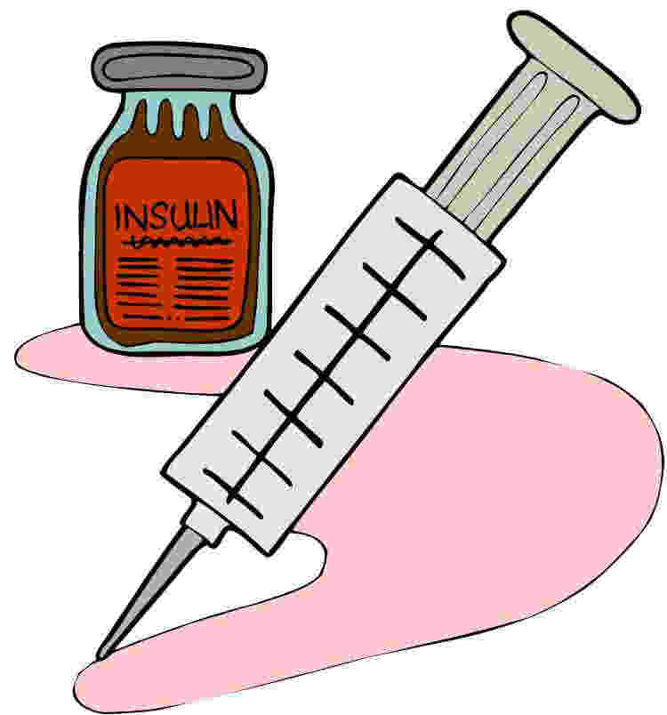
Author Beliefs and Reasoning:
Diabetes:
Claim: “The Ketogenic diet can help you lose excess fat, which is closely linked to type 2 diabetes, prediabetes and metabolic syndrome”¹
Article 1: 6-week study. Lowered blood sugar, and several patients discontinued medication. Serum triglycerides lowered substantially, but other triglyceride levels rose (unsubstantially but these should have also decreased with a mean 6.6% reduction in weight). Hemoglobin A1C levels decreased by an average of 16%. However, there were a few patients who experienced ketoacidosis. The study comes with a warning to use this diet under close clinical supervision, but these patients still were hospitalized even with that.²⁷
Article 2: This article showed improvement in insulin sensitivity by up to 75%, as well as lowered a1c (but only by .5%) and reduced weight by a mean of about 4 pounds each (in only 2 weeks). However, calories were reduced by about 1,000 kcal per day (hard to maintain). The study was too short (3 weeks) and the control groups were skewed in favor of the study.²⁸
The patients technically did lose fat, but they would have lost fat with a reduction in caloric intake anyway. Also (in the first study) they were already GAINING fat in their liver tissue after only a few weeks. The second article was marked as disregarded by examiners.

Slide 23
Author Beliefs and Reasoning:
Diabetes (Continued):
Claim: ““The Ketogenic diet can help you lose excess fat, which is closely linked to type 2 diabetes, prediabetes and metabolic syndrome”¹
Article 3: This is technically not a Ketogenic diet study, but is actually a study on a protein fast. The patients are essentially being supplemented their vitamins and minerals and being fed protein at about 1.3g/lb target weight. While this eating style mimics the SKD, it is not the same. Also, the article states that the improvements in symptoms with this diet were primarily due to weight loss. While this is positive, adherence to intermittent fasting by patients long-term is likely to prove difficult.²⁹

Slide 24
Author Reasoning and Beliefs:
Diabetes:
Claim: “In yet another study, the Ketogenic group lost 24.4 pounds (11.1 kg), compared to 15.2 pounds (6.9 kg) in the higher-carb group. This is an important benefit when considering the link between weight and type 2 diabetes”¹
Article 4: I appreciate that this version of SKD (compared against a low GI diet) did not restrict calories expressly, but the food suggested was almost completely low calorie (and serving sizes were recommended). There was no information given on the low GI diet being compared against the SKD, even though the team gave the food list for the latter. As in every study I have seen regarding SKD against another weight loss diet, serum glucose was lower with the SKD patients and fasting blood glucose/insulin improved at about the same rate. Also, as usual, the LDL rose with the SKD study group and fell in the GI group.³⁰
Article 5: This article showed a favorable weight loss result with several obese patients lowering their serum glucose levels by about 55% on average, but this is of course due to depravation of carbohydrates which is not typically feasible for a diabetic long-term.⁹ Again, reduced serum levels of free-fatty acids and glucagon were reported, but this is due to starvation metabolism being utilized – which is not particularly ideal long-term for a patient that naturally experiences ketosis.³¹

Slide 25
Average Public Reader Impressions
First impression based on the title would be that this is a trustworthy and inexpensive introduction to the Keto diet. People would most likely be interested in this type of diet already, and would be looking at how to start.
They may be skeptical of the plethora of health claims “there’s no way this diet cures THIS many things…”
They might see the huge number of scholarly articles attached and think that surely at least of them must have some weight to them.
They may get excited about the thought of weight loss and reversal of several ailments while being able to eat a half pound of cheese every day - as well as avocado and fatty meats.

Slide 26
Probability Action
Lay individuals are likely to do some research on potential dangers, as there are none spelled out in the article itself.
Many people would likely try the diet for a while based on this article, and may neglect to pay attention to potential dangers as deeply as they should.
The people who attempt it may end up crashing out of their diet craze due to lethargy or the body’s natural desire for carbs and then feel like failures. This is likely to cause yo-yo dieting or even increased weight.

Slide 27
Methods and Strategy
I used Google Scholar to research several articles.
I used Science Direct for more scholarly journals – signed in through ASU’s Institution Login.
I researched metabolic processes between the stomach, intestines, liver¹¹, pancreas, heart¹⁵ and brain¹⁶ using search engine sources and various medical journals before researching these claims, during, and after.
I made sure to read unbiased articles primarily, with some pro and some con articles for good measure.
I studied effects of the SKD on the liver¹¹, dangers of starvation metabolism⁹, and risk of ketoacidosis³⁴ on my own (these were not addressed by the article). I also researched the benefits toward epilepsy³³ further, as the article only quoted one source there.

Slide 28
Fact-Checking Results
Weight Loss
Weight loss is possible with the Keto diet, but oftentimes the initial drop is due to water weight loss, and weight loss from this diet is equivalent to a low calorie, low fat diet after 1 year. ⁽¹⁴⁾⁽⁹⁾
Metabolism Efficiency
This diet is actually likely to have unfavorable metabolism outcomes partially for the metabolism due to its low rate of adherence; the body naturally needs carbs to function and will crave them endlessly. The long-term effects on altering the body’s natural metabolism are unknown, but it is likely that the shift from carbohydrates to fat will cause the body to hang on to every carbohydrate it receives and thusly store THAT as fat.⁹ This will most often result in a regaining of weight and an impaired metabolism that is now weak to processing one of its most readily-used energy sources.⁽³²⁾⁽⁹⁾

Slide 29
Fact-Checking Results
Filling Without Counting Calories
The SKD is definitely a diet with which you can feel full without calorie counting¹, but that is largely due to the high requirement for green vegetables and protein. Leafy greens should be a staple in any diet, and animal proteins consumed in large amounts have been known to prose negative side effects.¹¹
Heart Disease
The article claims benefits for heart disease through weight loss, but losses shown with the SKD are comparable to other diets.³⁴ LDL levels also increased in numerous studies.⁽³⁾⁽¹¹⁾⁽¹⁴⁾

Slide 30
Fact-Checking Results
Cancer
The outcomes here look favorable. However, clinicians should pay close attention to the weight status of the patient, as cancer patients often have an issue with excessive weight loss.³⁵ Dehydration is also of concern due to Keto’s known ability to cause water weight loss.¹⁰
Epilepsy
The Keto diet has been used for treatment of epilepsy for decades. The outcomes are generally positive for treatment here.³³

Slide 31
Fact-Checking Results
Parkinson’s/Alzheimer’s Disease
Research is advancing here and looks very promising. Neuroprotective qualities from the SKD have potential to be significant in coming years, but more research is needed.³⁶
Polycystic Ovary Syndrome
The Keto diet shows potential improvement for PCOS symptoms, but further research is needed.

Slide 32
Fact-Checking Results
Acne
This is still in research, but reducing sugar may reduce acne. However, excess fat from Keto may exacerbate the acne symptoms. Acne treatment though nutrition may be better on a case-by-case basis.²⁶
Diabetes
Diabetes, in my professional opinion, would be better managed long-term using a lowered (versus scant) carbohydrate diet with moderate fat intake coming mostly from plants.³⁴
Long-term weight loss with SKD is the same as it would be utilizing a standard low-fat diet with fewer possible negative side effects.³⁴
High fat content of SKD may advance risk for high cholesterol/heart disease/may reduce carbohydrate tolerance long-term.³² Also, excess fat can increase liver steatosis¹¹ (these are all high-risk for Diabetics).
Forced ketosis may cause ketoacidosis for a diabetic patient, which is potentially fatal. This was seen in some of the studies posted in the article – and those diabetics were under close clinical supervision²⁷

Slide 33
Conclusions
The Ketogenic diet has many established and some promising benefits for certain ailments
The SKD has been shown to have negative effects on blood cholesterol and should therefore not be attempted in its current form for weight loss or by individuals with heart and/or liver disease¹¹ or risk factors for these.
The SKD may have great benefits for epileptics³³ and shows promise in treatment of cancer.³⁵ More research is needed on the latter as well as on SKD’s effects on neurological diseases.
Most articles either suggested more research is needed or were insufficient in duration of study (or lack of controls, other skews).
There were many articles on the subject, more articles opposed the claims than supported them, but there were articles both supporting and opposing Keto.

Slide 34
Author’s Reliability
Rudy Mawer is a Sports and Weight Loss Nutritionist¹
He is a Certified Sports Nutritionist and has a Master’s in Science.¹
Mr. Mawer has the expertise to study the Keto diet, but is likely to have persuasive bias (as he sells various versions of the diet and may have donated money to Healthline to post this article (there is a disclaimer on the article).¹

Slide 35
Ethical Issues
There is a suspected persuasive bias in the article, especially since no cons of the diet are noted (and because the poster sells versions of this diet).
The information could have potential long-term health effects, particularly for high-risk patients. There could possibly also be financial implications if a patient purchased a diet plan based on this article
The author was careful to mention “possible” favorable outcomes, but the claims are bolded and the “potential” was not. The article states that more research is needed, but it is deceptively tucked away in small print and grayed-out boxes. The advertising is likely sales-oriented.¹

Slide 36
Potential Outcomes for Readers
Readers are likely to either want to try the Keto diet or believe it is too good to be true.
The article could have a potentially negative effect if the patient tries the diet and experiences disordered eating or health-related issues.
The SKD could be positive if it helps an obese person turn their weight around and keep it off without causing negative side effects, or helps any of the other claimed ailments without possible negative outcomes.

Slide 37
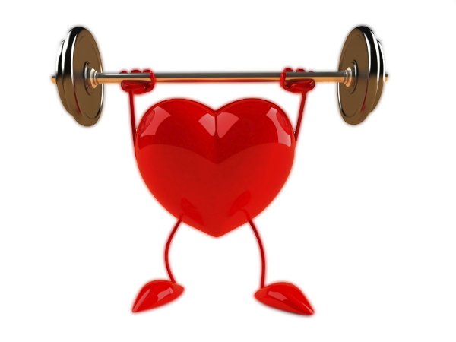
What I Have Learned
I learned interesting potential benefits the SKD can provide, especially in the realm of cancer and neurological disorders⁽³⁵⁾⁽³⁶⁾
The Keto diet is something I personally would not recommend to anyone as a means of weight loss, for treatment of heart disease, or for diabetic homeostasis (due to high risk of ketoacidosis from scant carbs/increased risk for heart disease from high fat content). I would instead suggest lowered carbs, moderate healthy fats, and moderate (and mostly plant-based) fats (adjusted case-by-case).
Keto has helped people lose weight, but losses have been comparatively similar to other, more long-term solutions (such as low calorie/lowered fat plans with low/moderate carbs) which prose fewer potential side-effects (such as risk for fatty liver disease¹¹ and metabolism sub-optimization⁹).

Slide 38
What I Have Learned
If a client/patient asked me my thoughts on the Keto diet, I would explain to them that it is a good option for specific ailments but does not seem to be as good for others.
Since my main focus is on Diabetes and Obesity, I am unlikely to recommend the Keto diet to many. However, I would be likely to recommend it to a cancer patient – particularly an overweight patient who has cancer, but with the understanding that they stay in constant contact with me and/or their physician (in case they lose weight too quickly).
I would be very likely to recommend this diet for epileptics with difficult to treat seizure disorder, but only after they have attempted medicine that has failed them. I would be more hesitant to suggest this to a child; I would not want to deprive a child’s growing body from needed carbohydrates, as this may stunt their growth.

Slide 39
References
(Articles in green are my additions to the research)
Mawer R. The Ketogenic Diet: A Detailed Beginner's Guide to Keto. Healthline. https://www.healthline.com/nutrition/ketogenic-diet-101#types. Published 2018. Accessed January 21, 2019.
2. Dietary Reference Intakes for Energy a. Dietary Reference Intakes for Energy, Carbohydrate, Fiber, Fat, Fatty Acids, Cholesterol, Protein, and Amino Acids : Health and Medicine Division. Nationalacademies.org. http://www.nationalacademies.org/hmd/Reports/2002/Dietary-Reference- Intakes-for-Energy-Carbohydrate-Fiber-Fat-Fatty-Acids-Cholesterol-Protein-and- Amino-Acids.aspx. Published 2019. Accessed February 2, 2019.
Westman EC e. A review of low-carbohydrate ketogenic diets. - PubMed - NCBI. Ncbi.nlm.nih.gov. https://www.ncbi.nlm.nih.gov/pubmed/14525681. Published 2019. Accessed January 24, 2019.
Fukao T e. Pathways and control of ketone body metabolism: on the fringe of lipid biochemistry. - PubMed - NCBI. Ncbi.nlm.nih.gov. https://www.ncbi.nlm.nih.gov/pubmed/14769483. Published 2004. Accessed January 24, 2019.

Slide 40
References
5. RL V. The therapeutic implications of ketone bodies: the effects of ketone bodies in pathological conditions: ketosis, ketogenic diet, redox states, insu... - PubMed - NCBI. Ncbi.nlm.nih.gov. https://www.ncbi.nlm.nih.gov/pubmed/14769489. Published 2004. Accessed January 24, 2019.
6. GM R. Diet and Syndrome X. - PubMed - NCBI. Ncbi.nlm.nih.gov. https://www.ncbi.nlm.nih.gov/pubmed/11122785. Published 2000. Accessed February 1, 2019.
7. VA Z. Insulin stimulation of hepatic triacylglycerol secretion in the insulin-replete state: implications for the etiology of peripheral insulin resistance. - PubMed - NCBI. Ncbi.nlm.nih.gov. https://www.ncbi.nlm.nih.gov/pubmed/12079835. Published 2002. Accessed January 28, 2019.
8. Manninen A. Very-low-carbohydrate diets and preservation of muscle mass. Nutr Metab (Lond). 2006;3(1). doi:10.1186/1743-7075-3-9. Accessed February 1, 2019.
9. Naisbitt C, Davies S. Starvation, exercise and the stress response. Anaesthesia & Intensive Care Medicine. 2017;18(10):508-512. doi:10.1016/j.mpaic.2017.06.020. Accessed January 25, 2019.

Slide 41
References
10. Yang M, Van Itallie T. Composition of weight lost during short-term weight reduction. Metabolic responses of obese subjects to starvation and low-calorie ketogenic and nonketogenic diets. Journal of Clinical Investigation. 1976;58(3):722-730. doi:10.1172/jci108519. Accessed January 25, 2019.
11. Asrih M, Jornayvaz F. Diets and nonalcoholic fatty liver disease: The good and the bad. Clinical Nutrition. 2014;33(2):186-190. doi:10.1016/j.clnu.2013.11.003. Accessed January 25, 2019.
12. Phinney S, Bistrian B, Evans W, Gervino E, Blackburn G. The human metabolic response to chronic ketosis without caloric restriction: Preservation of submaximal exercise capability with reduced carbohydrate oxidation. Metabolism. 1983;32(8):769-776. doi:10.1016/0026-0495(83)90106-3. Accessed January 25, 2019.
13. Johnstone AM e. Effects of a high-protein ketogenic diet on hunger, appetite, and weight loss in obese men feeding ad libitum. - PubMed - NCBI. Ncbi.nlm.nih.gov. https://www.ncbi.nlm.nih.gov/pubmed/18175736. Published 2019. Accessed January 25, 2019.

Slide 42
References
14. Hession M e. Systematic review of randomized controlled trials of low-carbohydrate vs. low-fat/low-calorie diets in the management of obesity and its comorbidit... - PubMed - NCBI. Ncbi.nlm.nih.gov. https://www.ncbi.nlm.nih.gov/pubmed/18700873. Published 2009. Accessed January 28, 2019.
15. Santos FL e. Systematic review and meta-analysis of clinical trials of the effects of low carbohydrate diets on cardiovascular risk factors. - PubMed - NCBI. Ncbi.nlm.nih.gov. https://www.ncbi.nlm.nih.gov/pubmed/22905670. Published 2012. Accessed January 28, 2019.
16. Zhou W, Mukherjee P, Al. e. The calorically restricted ketogenic diet, an effective alternative therapy for malignant brain cancer. ncbi.gov. https://www.ncbi.nlm.nih.gov/pmc/articles/PMC1819381/. Published 2007. Accessed January 28, 2019.
17. Vidali S, Aminzadeh S, Lambert B et al. Mitochondria: The ketogenic diet—A metabolism-based therapy. Int J Biochem Cell Biol. 2015;63:55-59. doi:10.1016/j.biocel.2015.01.022

Slide 43
References
18. Klement R. Calorie or Carbohydrate Restriction? The Ketogenic Diet as Another Option for Supportive Cancer Treatment. Oncologist. 2013;18(9):1056-1056. doi:10.1634/theoncologist.2013-0032
19. Hemingway C e. The ketogenic diet: a 3- to 6-year follow-up of 150 children enrolled prospectively. - PubMed - NCBI. Ncbi.nlm.nih.gov. https://www.ncbi.nlm.nih.gov/pubmed/11581442. Published 2001. Accessed January 28, 2019.
20. Gasior M, Rogawski M, Hartman A. Neuroprotective and disease-modifying effects of the ketogenic diet. Behav Pharmacol. 2006;17(5-6):431-439. doi:10.1097/00008877-200609000-00009
21. Choragiewicz T e. [Anticonvulsant and neuroprotective effects of the ketogenic diet]. - PubMed - NCBI. Ncbi.nlm.nih.gov. https://www.ncbi.nlm.nih.gov/pubmed/20687386. Published 2010. Accessed January 27, 2019.

Slide 44
References
22. McPherson P, McEneny J. The biochemistry of ketogenesis and its role in weight management, neurological disease and oxidative stress. J Physiol Biochem. 2011;68(1):141-151. doi:10.1007/s13105-011-0112-4
23. VanItallie T, Nonas C, Di Rocco A, Boyar K, Hyams K, Heymsfield S. Treatment of Parkinson disease with diet-induced hyperketonemia: A feasibility study. Neurology. 2005;64(4):728-730. doi:10.1212/01.wnl.0000152046.11390.45
24. Prins M, Fujima L, Hovda D. Age-dependent reduction of cortical contusion volume by ketones after traumatic brain injury. J Neurosci Res. 2005;82(3):413-420. doi:10.1002/jnr.20633
25. Galletly C, Moran L, Noakes M, Clifton P, Tomlinson L, Norman R. Psychological benefits of a high-protein, low-carbohydrate diet in obese women with polycystic ovary syndrome—A pilot study. Appetite. 2007;49(3):590-593. doi:10.1016/j.appet.2007.03.222
26. Paoli A, Grimaldi K, Toniolo L, Canato M, Bianco A, Fratter A. Nutrition and Acne: Therapeutic Potential of Ketogenic Diets. Skin Pharmacol Physiol. 2012;25(3):111-117. doi:10.1159/000336404

Slide 45
References
27. Yancy, Jr. W, Al e. A low-carbohydrate, ketogenic diet to treat type 2 diabetes. Nutr Metab. 2005. doi:10.1186/1743-7075-2-34
28. Bessesen D. Effect of a Low-Carbohydrate Diet on Appetite, Blood Glucose Levels, and Insulin Resistance in Obese Patients With Type 2 Diabetes. Yearbook of Endocrinology. 2006;2006:149-151. doi:10.1016/s0084-3741(08)70336-6
29. Bistrian B, Blackburn G, Flatt J, Sizer J, Scrimshaw N, Sherman M. Nitrogen Metabolism and Insulin Requirements in Obese Diabetic Adults on a Protein-Sparing Modified Fast. Diabetes. 1976;25(6):494-504. doi:10.2337/diab.25.6.494
30. Westman E, Yancy W, Mavropoulos J, Marquart M, McDuffie J. The effect of a low-carbohydrate, ketogenic diet versus a low-glycemic index diet on glycemic control in type 2 diabetes mellitus. Nutr Metab (Lond). 2008;5(1). doi:10.1186/1743-7075-5-36
31. Henry R, Wallace P, Olefsky J. Effects of Weight Loss on Mechanisms of Hyperglycemia in Obese Non-Insulin-Dependent Diabetes Mellitus. Diabetes. 1986;35(9):990-998. doi:10.2337/diab.35.9.990

Slide 46
References
32. Tognini P, Murakami M, Liu Y et al. Distinct Circadian Signatures in Liver and Gut Clocks Revealed by Ketogenic Diet. Cell Metab. 2017;26(3):523-538.e5. doi:10.1016/j.cmet.2017.08.015
33. Huttenlocher P. Ketonemia and Seizures: Metabolic and Anticonvulsant Effects of Two Ketogenic Diets in Childhood Epilepsy. Pediatr Res. 1976;10(5):536-540. doi:10.1203/00006450-197605000-00006
34. Iqbal N, Vetter M, Moore R et al. Effects of a Low-intensity Intervention That Prescribed a Low-carbohydrate vs. a Low-fat Diet in Obese, Diabetic Participants. Obesity. 2009;18(9):1733-1738. doi:10.1038/oby.2009.460
35. Hudson E, Tisdale M. Alterations in plasma and tumour levels of fatty acids with weight loss in an experimental cachexia model. Prostaglandins, Leukotrienes and Essential Fatty Acids. 1994;50(5):229-234. doi:10.1016/0952-3278(94)90158-9
36. Henderson S. Ketone bodies as a therapeutic for Alzheimer’s disease. Neurotherapeutics. 2008;5(3):470-480. doi:10.1016/j.nurt.2008.05.004

Slide 47
References
37. Chiorondo M, Williams D. 'No One Should Be Doing Keto Diet' Says Leading Cardiologist. Plantbasednews.org. https://www.plantbasednews.org/post/no-one-should-be-doing-keto-diet-leading-cardiologist. Published 2018. Accessed January 22, 2019.

Slide 48
Images Used:
Image 1. Avocado - https://gallery.yopriceville.com/Free-Clipart-Pictures/Fruit-PNG/Avocado_PNG_Clip_Art#.XEt-IVxKhPY. Accessed January 23, 2019.
Image 2. Life Cycle. http://www.clipartpanda.com/clipart_images/tree-life-cycle-clipart-64873156 - Accessed January 23, 2019.
Image 3. Keto Food Pyramid. https://www.123rf.com/clipart-vector/keto.html?sti=ncbp78kr34c5fa3d9x|&mediapopup=94309675 – Accessed January 23, 2019.
Image 4. Diabetes Insulin. http://clipart-library.com/clipart/2081290.htm - Accessed January 28, 2019.
Image 5. Weight Loss Rainbow. https://thecampusconnect.com/2018/05/31/20-myths-about-how-to-lose-weight-fast/ - Accessed January 28, 2019.
Image 6. Research Blonde Girl. http://worldartsme.com/computer-research-clipart.html#gal_post_32428_computer-research-clipart-1.jpg - Accessed January 29, 2019.

